Slide 1
University of Diyala
College of Engineering
Department of Electronics Engineering
Course Number: U103
Course Name: Computer Networks
Lecture (2)
Asst. Lect. Ahmed Mohammed Ahmed

Slide 2
Categories of Networks
The category into which a network falls is determined by its size. A LAN normally covers an area less than 2 miles; a WAN can be worldwide. Networks of a size in between are normally referred to as metropolitan area networks and span tens of miles.

Slide 3
Local Area Networks (LANs)
A local area network (LAN) is usually privately owned and links the devices in a single office, building, or campus (see Figure 1). Depending on the needs of an organization and the type of technology used, a LAN can be as simple as two PCs and a printer in someone's home office; or it can extend throughout a company and include audio and video peripherals. Currently, LAN size is limited to a few kilometers.

Slide 4
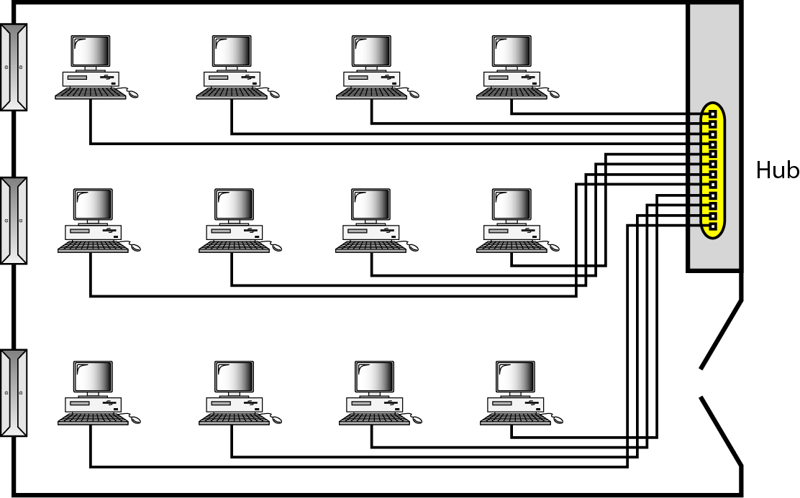

Slide 5
LANs are designed to allow resources to be shared between personal computers or workstations. The resources to be shared can include hardware (e.g., a printer), software (e.g., an application program), or data. A common example of a LAN, found in many business environments, links a workgroup of task-related computers, for example, engineering workstations or accounting PCs. One of the computers may be given a large capacity disk drive and may become a server to clients. Software can be stored on this central server and used as needed by the whole group. In this example, the size of the LAN may be determined by licensing restrictions on the number of users per copy of software, or by restrictions on the number of users licensed to access the operating system. In addition to size, LANs are distinguished from other types of networks by their transmission media and topology. In general, a given LAN will use only one type of transmission medium. The most common LAN topologies are bus, ring, and star. Early LANs had data rates in the 4 to 16 megabits per second (Mbps) range. Today, however, speeds are normally 100 or 1000 Mbps.

Slide 6
Wide Area Networks (WANs)
A wide area network (WAN) provides long-distance transmission of data, image, audio, and video information over large geographic areas that may comprise a country, a continent, or even the whole world. A WAN can be as complex as the backbones that connect the Internet or as simple as a dial-up line that connects a home computer to the Internet. We normally refer to the first as a switched WAN and to the second as a point-to-point WAN (Figure 2).

Slide 7
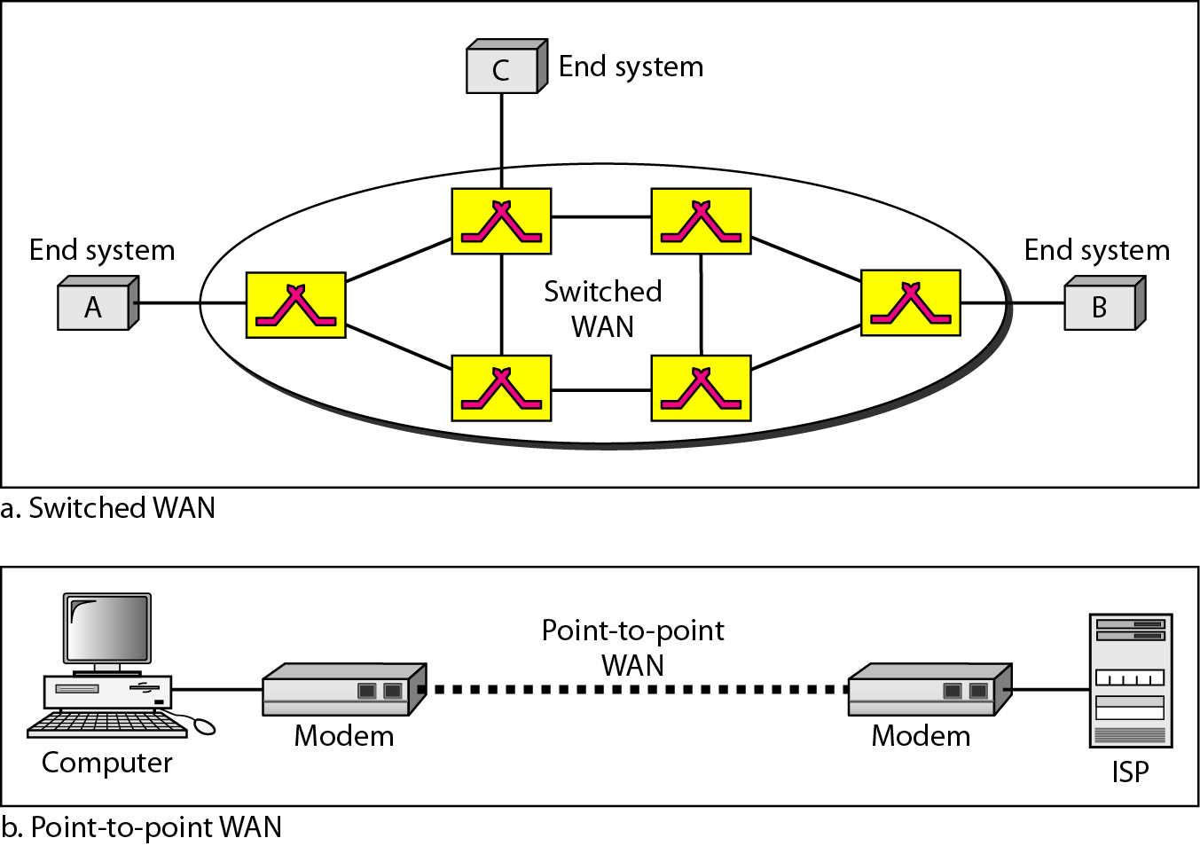

Slide 8
Metropolitan Area Networks (MANs)
A metropolitan area network (MAN) is a network with a size between a LAN and a WAN. It normally covers the area inside a town or a city. It is designed for customers who need a high-speed connectivity, normally to the Internet, and have endpoints spread over a city or part of city. A good example of a MAN is the part of the telephone company network that can provide a high-speed (Digital Subscriber Line) DSL line to the customer. Another example is the cable TV network that originally was designed for cable TV, but today can also be used for high-speed data connection to the Internet.

Slide 9
Interconnection of Networks: Internetwork: - Today, it is very rare to see a LAN, a MAN, or a LAN in isolation; they are connected to one another. When two or more networks are connected, they become an internetwork, or internet.
As an example, assume that an organization has two offices, one on the east coast and the other on the west coast. The established office on the west coast has a bus topology LAN; the newly opened office on the east coast has a star topology LAN. The president of the company lives somewhere in the middle and needs to have control over the company from her home. To create a backbone WAN for connecting these three entities (two LANs and the president's computer), a switched WAN operated by a service provider such as a telecom company) has been leased. To connect the LANs to this switched WAN, however, three point-to-point WANs are required. These point-to-point WANs can be a high-speed DSL line offered by a telephone company or a cable modern line offered by a cable TV provider as shown in Figure 3.

Slide 10
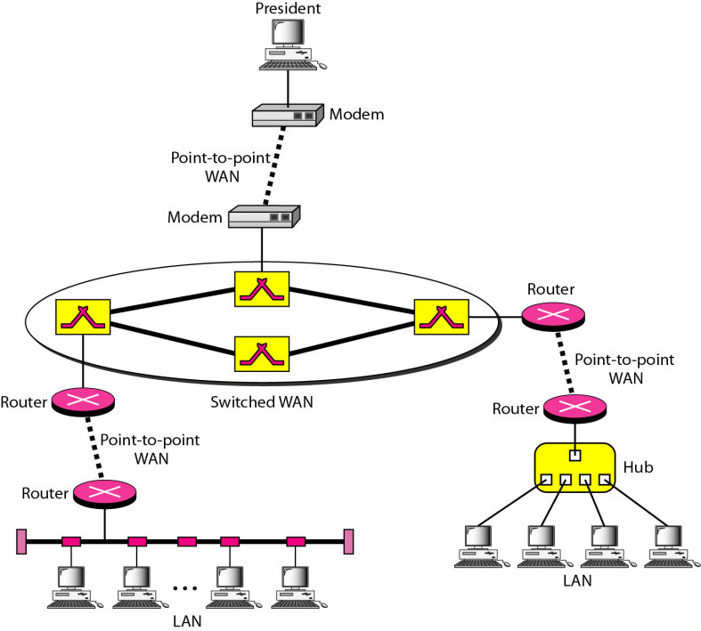

Slide 11
PROTOCOLS AND STANDARDS
Protocol:-In computer networks, communication occurs between entities in different systems. An entity is anything capable of sending or receiving information. However, two entities cannot simply send bit streams to each other and expect to be understood. For communication to occur, the entities must agree on a protocol. A protocol is a set of rules that govern data communications. A protocol defines what is communicated, how it is communicated, and when it is communicated. The key elements of a protocol are syntax, semantics, and timing.

